Slide 1
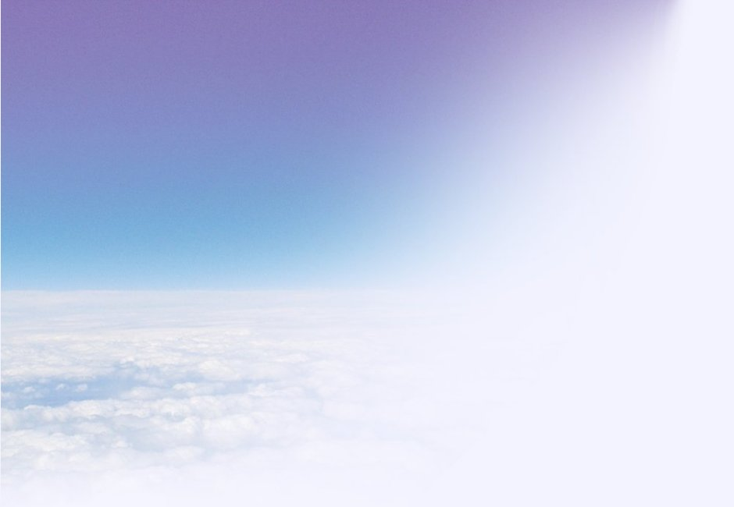
Pixel Transposed Convolution
Improving on the existing methods of transposed convolution used for up-sampling in neural networks that perform semantic segmentation.

Slide 2
What is Transposed Convolution (TCL)?
Convolution and deconvolution find their use in semantic segmentation, where features are to be extracted from the images and each pixel is to classified into one of the many output classes.
Transposed convolution is a process which up-samples the input using the process of convolution by an integer factor.
This process is occasionally referred to as deconvolution, which becomes a source of confusion since it also refers to the operation which is the mathematical inverse of convolution. To avoid this, we will use the term transposed convolution to describe the process.
This process is used to reverse the effects of convolution in a convolutional neural network. (very much like deconvolution, but mathematically they are distinct)
Demonstration of Transposed Convolution. This and the GIFs in the following slides were taken from Ref 4. [4]

Slide 3
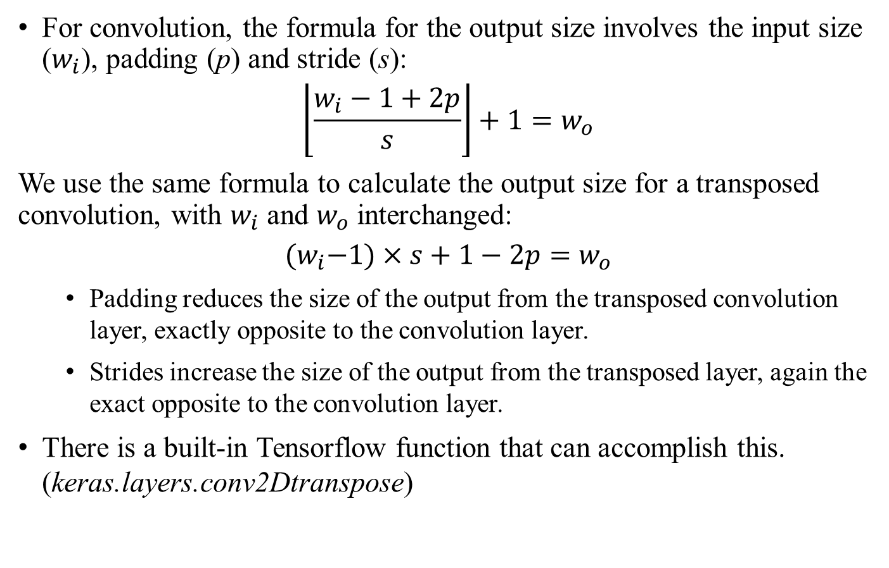
What is Transposed Convolution (TCL) [contd.]?
For convolution, the formula for the output size involves the input size ($w_{i}$), padding (p) and stride (s):
$$\left\lfloor \frac{w_{i}−1+2p}{s}\right\rfloor +1=w_{o}$$
We use the same formula to calculate the output size for a transposed convolution, with $w_{i}$ and $w_{o}$ interchanged:
$${(w}_{i}−1)×s+1−2p=w_{o}$$
Padding reduces the size of the output from the transposed convolution layer, exactly opposite to the convolution layer.
Strides increase the size of the output from the transposed layer, again the exact opposite to the convolution layer.
There is a built-in Tensorflow function that can accomplish this. (keras.layers.conv2Dtranspose)

Slide 4
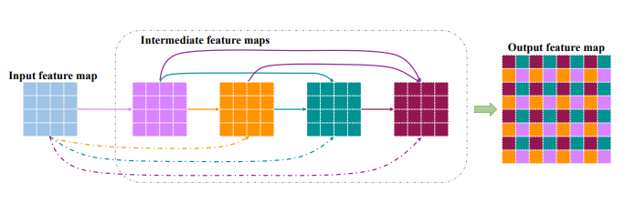
What is Pixel Transposed Convolution (Pixel TCL)?
Pixel transposed convolution was introduced by Gao et al. in 2017. [1]
This method was introduced to mitigate checkerboard effects that occur due to loss of information about neighbouring pixels during the process of up-sampling.
The increase in size is achieved through padding the resulting feature maps with zero vectors, and they are added in a manner that the non-zero elements aren’t superimposed in the final feature map.(Refer to figure in Slide 7)
PixelTCL(solid lines in the figure) and iPixelTCL (dotted lines in the figure) use convolutions that start from the input image, sequentially, until there are enough feature maps to combine them to form a bigger feature map. These feature maps use concatenation with all of the previous feature maps (for PixelTCL, all feature maps except the input) before each convolution. (Refer to pseudocode in Slide 7)
PixelTCL and iPixelTCL in concept, Ref 1. [1]

Slide 5
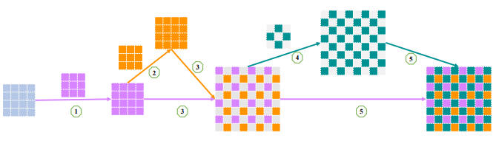
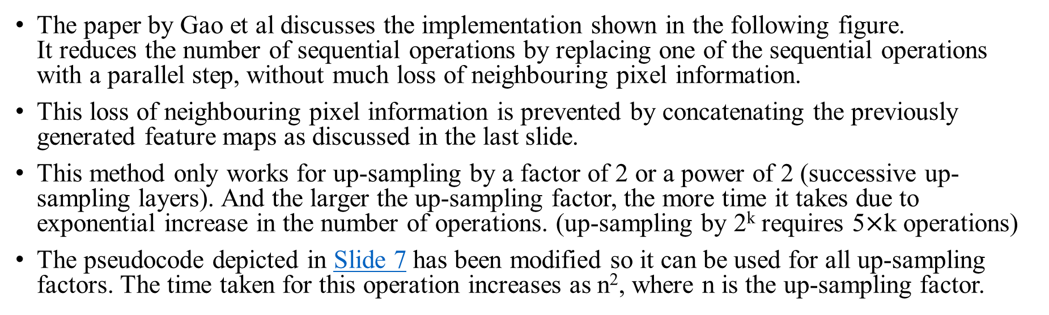
Implementation of PixelTCL and iPixelTCL
The paper by Gao et al discusses the implementation shown in the following figure. It reduces the number of sequential operations by replacing one of the sequential operations with a parallel step, without much loss of neighbouring pixel information.
This loss of neighbouring pixel information is prevented by concatenating the previously generated feature maps as discussed in the last slide.
This method only works for up-sampling by a factor of 2 or a power of 2 (successive up-sampling layers). And the larger the up-sampling factor, the more time it takes due to exponential increase in the number of operations. (up-sampling by 2^{k} requires 5$×$k operations)
The pseudocode depicted in Slide 7 has been modified so it can be used for all up-sampling factors. The time taken for this operation increases as n², where n is the up-sampling factor.
PixelTCL implementation, Ref 1. [1]. This diagram doesn’t show the concatenations with all of the previous input at each stage.
Refer to Slide 6 for pseudocode implementation.

Slide 6
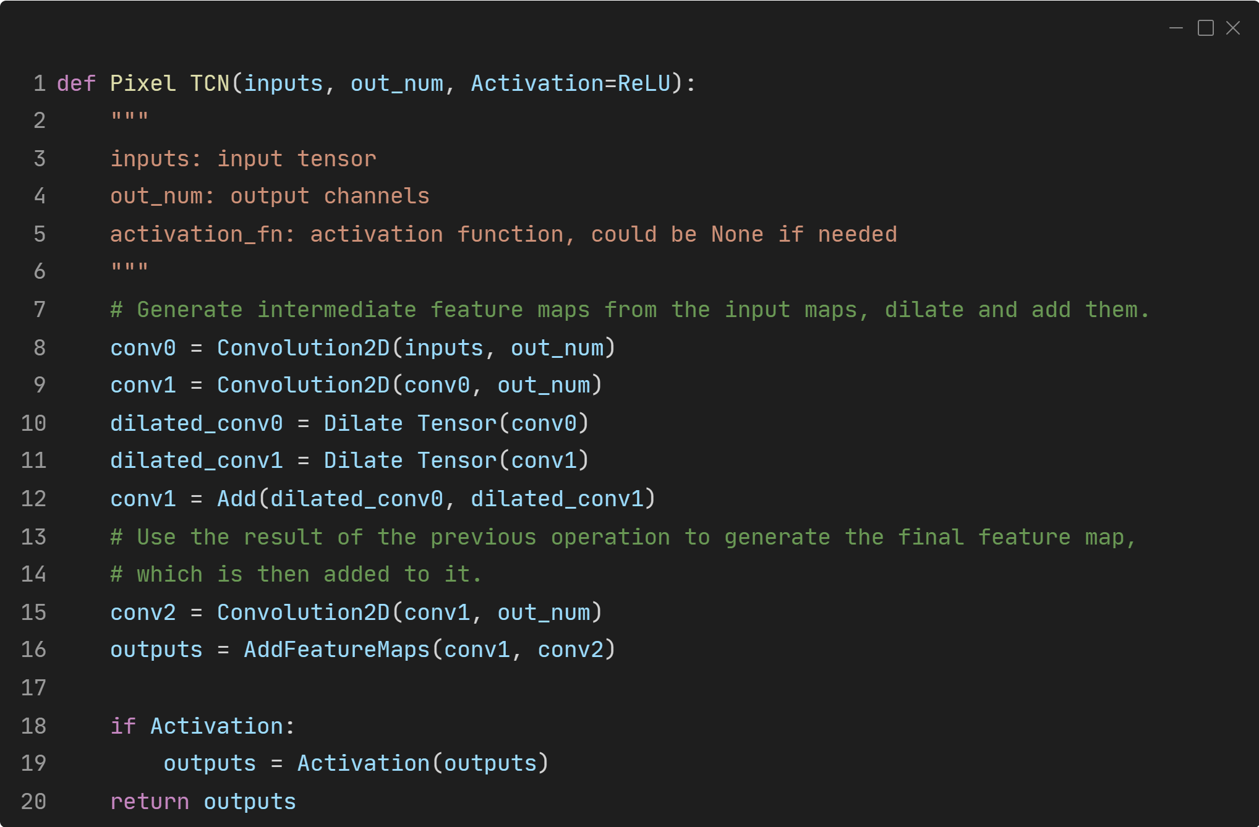
Pixel and iPixel TCL: pseudocode of the original implementation
PixelTCL implementation as shown in the previous slide. Code sourced from: PixelTCN GitHub, Hongyang Gao, [1]
iPixelTCL implementation. Code sourced from: PixelTCN GitHub, Hongyang Gao, [1]

Slide 7
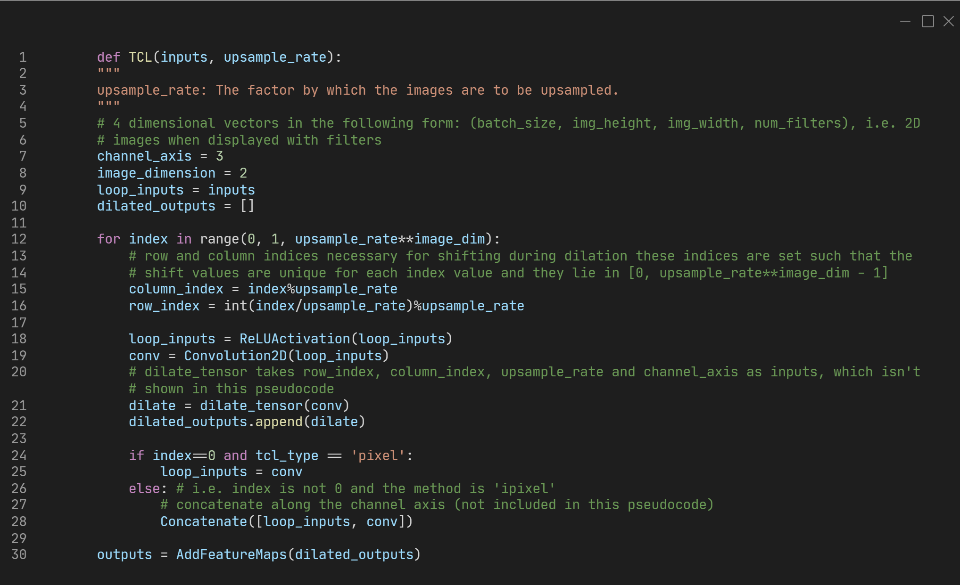
Pixel and iPixel TCL pseudocode 2 (works for all sampling factors)

Slide 8
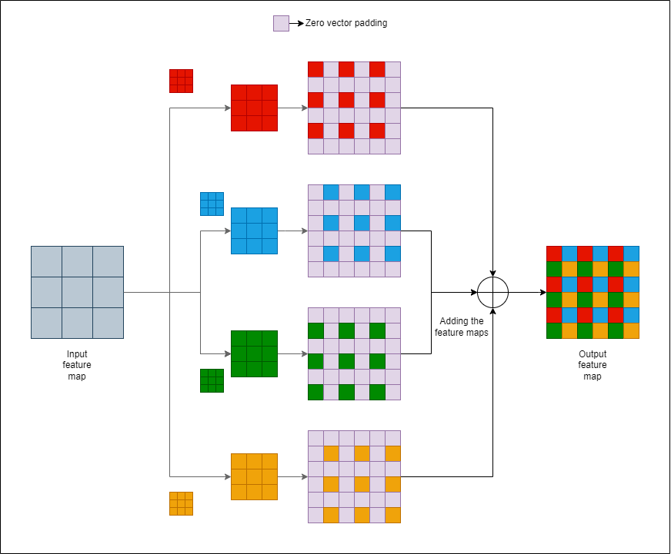
Modified iPixel TCL
The modified iPixel TCL uses the same input map to generate k² maps through convolution, and then combines them to generate an up-sampled map as shown in the schematic that follows. (k is the scaling factor)
This method can be used for any integer scaling factor, unlike PixelTCL.
The feature maps can be generated independently (using parallel operations), which means that the entire operation can be done in constant time. However, the zero padding operations increase as (k-1)², which consumes some considerable amount of time. The number of operations are still less than PixelTCL for the same level of upscaling.
The modified iPixelTCL process. All of the feature maps stem directly from the input feature map, which are eventually rearranged to form one bigger feature map. Implementation details in Slide 9.

Slide 9
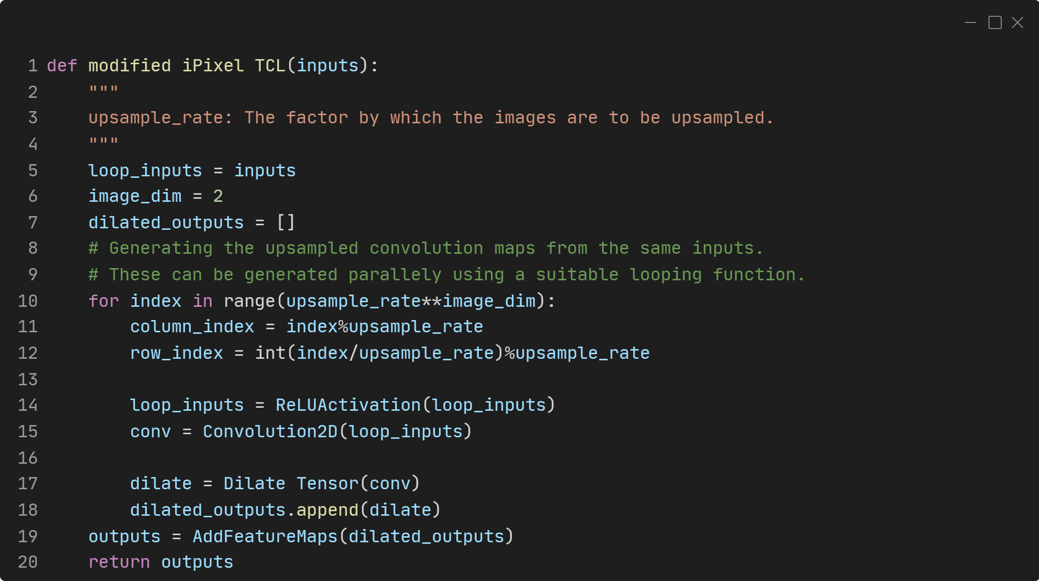
Modified iPixelTCL – pseudocode for implementation

Slide 10
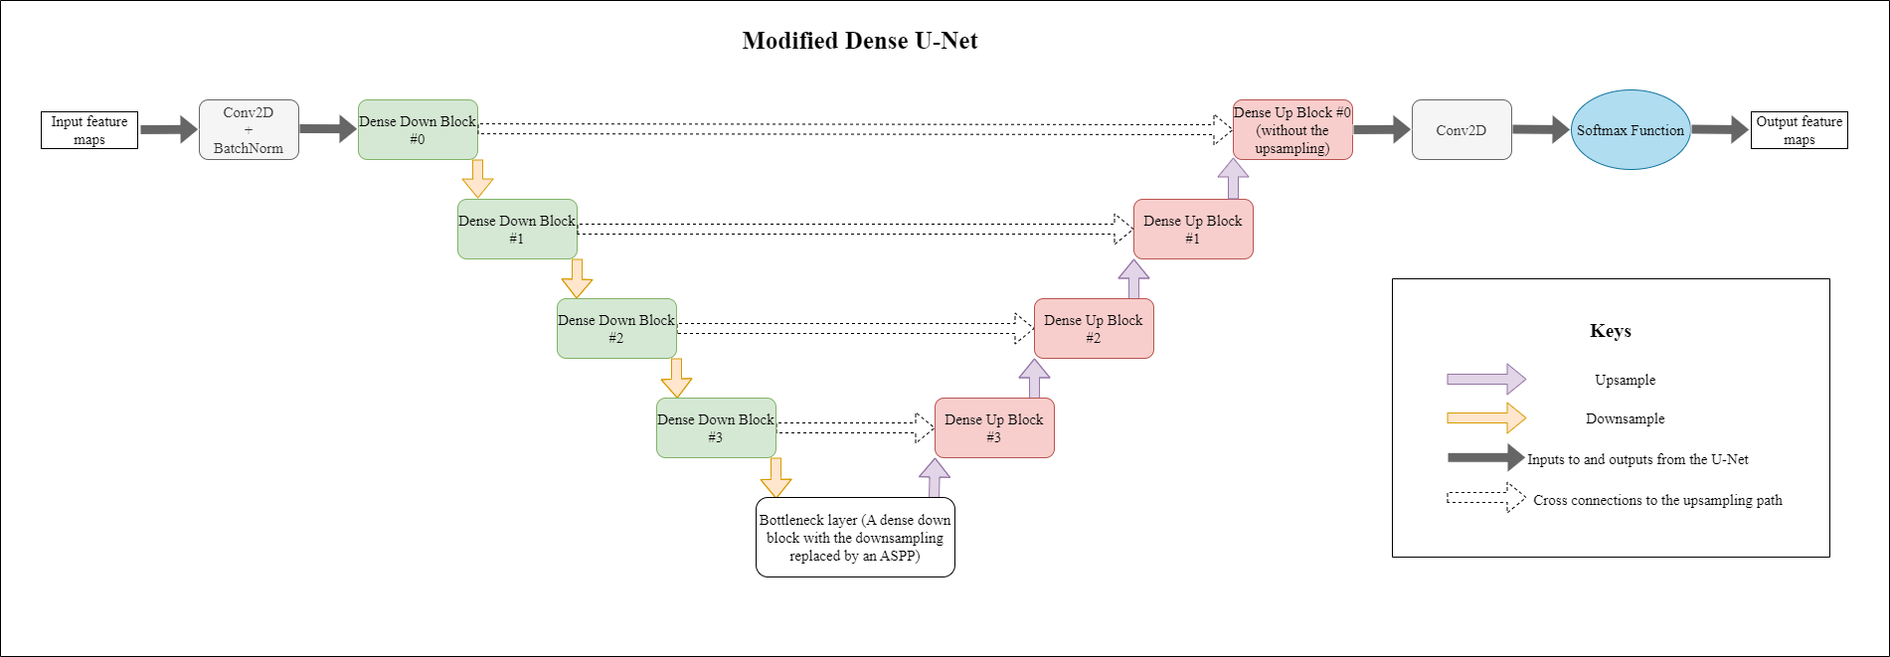
Model used for evaluation
The code for this project is a sophisticated U-Net with the following attributes:
An atrous spatial pyramidal pooling (ASPP) bottleneck layer.
Down-sampling blocks composed of dense blocks (consecutive dense layers with concatenation as described in Ref. 3) followed by a down-sampling layer (which are convolution based instead of max-pooling based to improve the performance) [2][3]
Up-sampling blocks are composed of up-sampling layer (either of the following: TCL, PixelTCL, iPixelTCL or modified iPixelTCL) followed by a dense layer.

Slide 11
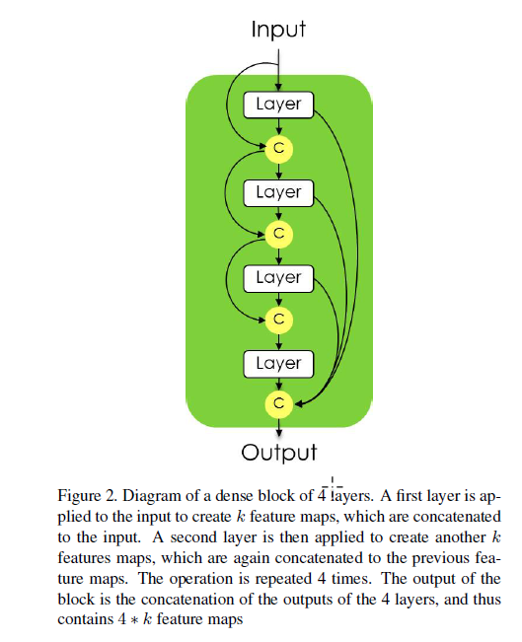
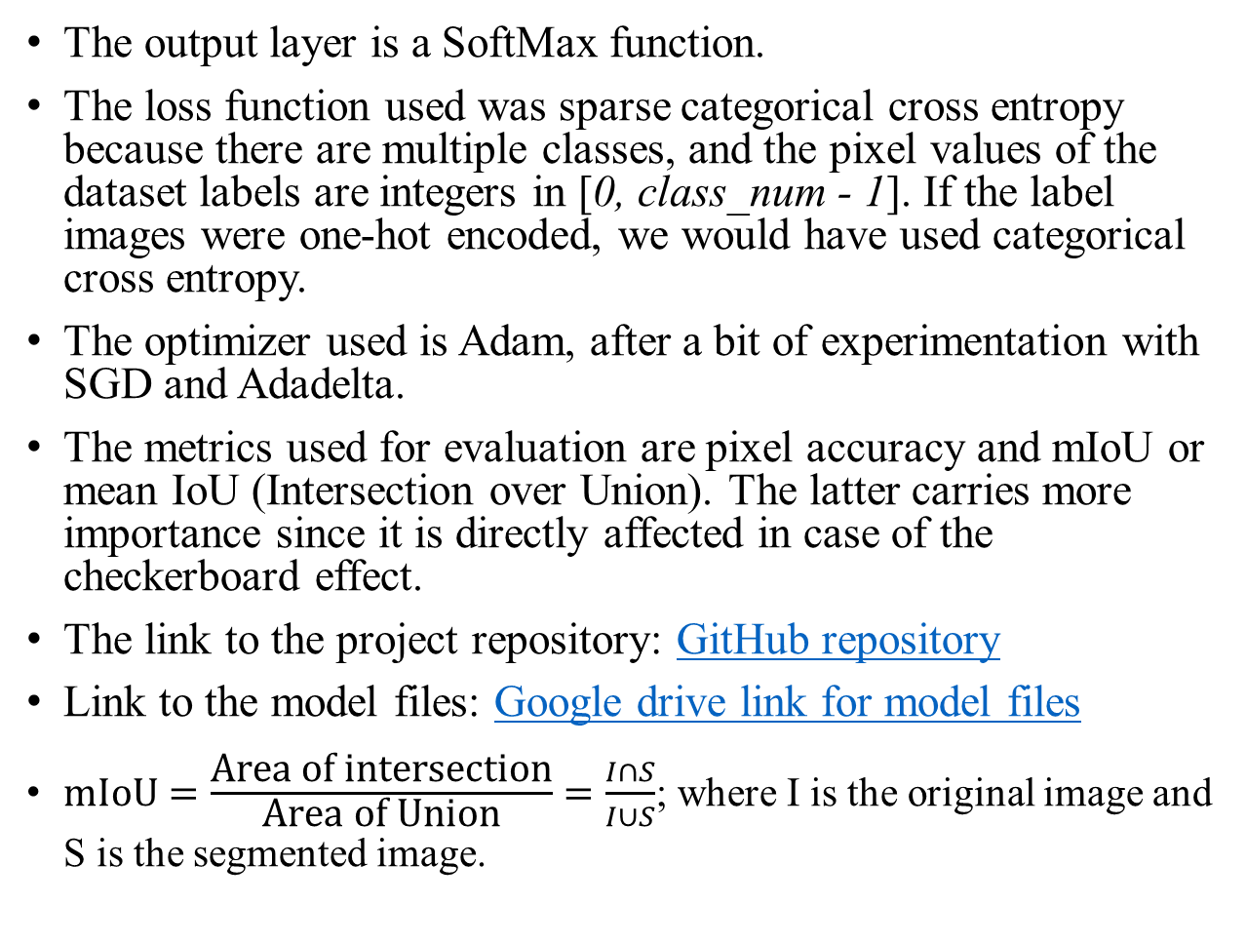
Model used for evaluation (contd.)
The output layer is a SoftMax function.
The loss function used was sparse categorical cross entropy because there are multiple classes, and the pixel values of the dataset labels are integers in [0, class_num - 1]. If the label images were one-hot encoded, we would have used categorical cross entropy.
The optimizer used is Adam, after a bit of experimentation with SGD and Adadelta.
The metrics used for evaluation are pixel accuracy and mIoU or mean IoU (Intersection over Union). The latter carries more importance since it is directly affected in case of the checkerboard effect.
The link to the project repository: GitHub repository
Link to the model files: Google drive link for model files
$\text{mIoU}=\frac{\text{Area} \text{of} \text{intersection}}{\text{Area} \text{of} \text{Union}}=\frac{I∩S}{I∪S}$; where I is the original image and S is the segmented image.
Dense Layer used in the model. The diagram and the description is from Reference 3. [3]

Slide 12
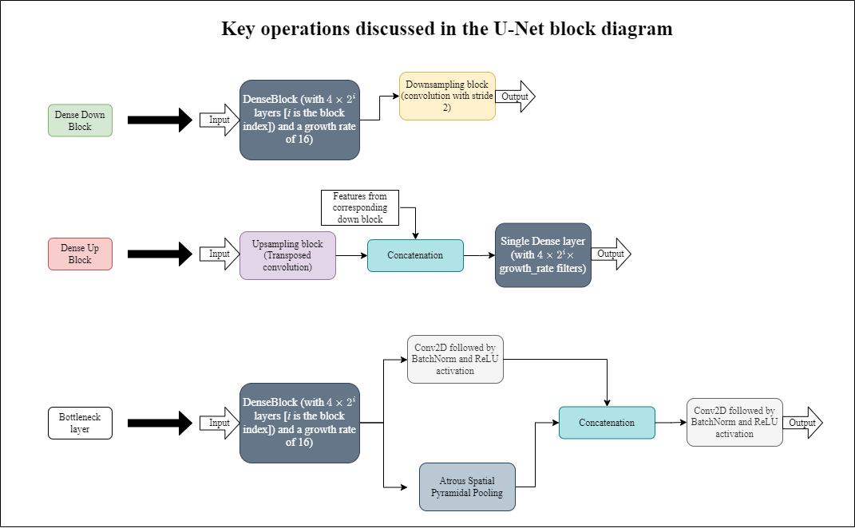
Model used for evaluation (contd.)
The blocks from the modified U-Net discussed in Slide 10 in greater detail.

Slide 13
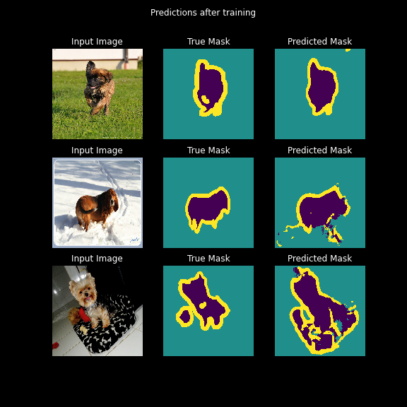
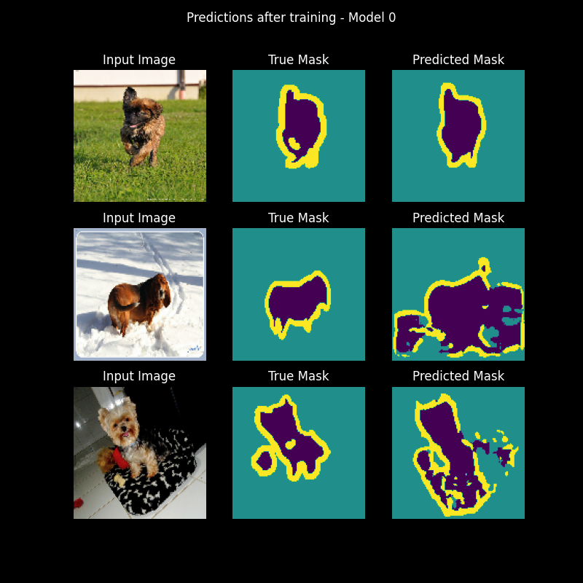
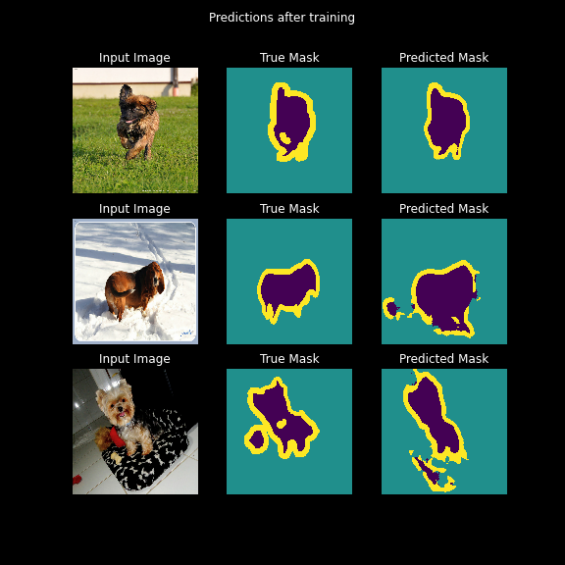

Results
Model 0 – DenseUNet with conv2dtranspose
Model 1 – DenseUNet with PixelTCL
Model 2 – DenseUNet with iPixelTCL
Model 3 – DenseUNet with modified iPixelTCL
Note: The results are based off a small number of epochs (10) due to hardware limitations.
Note 2: These models were compared with regular convolution

Slide 14
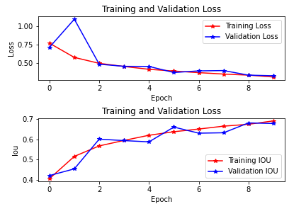
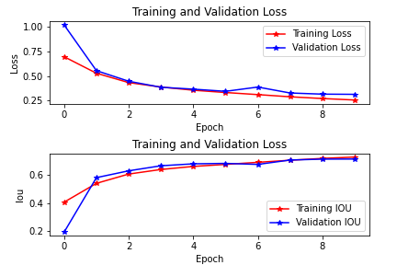
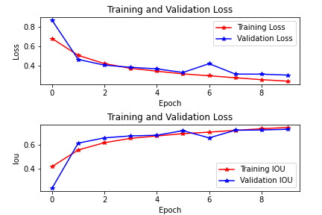
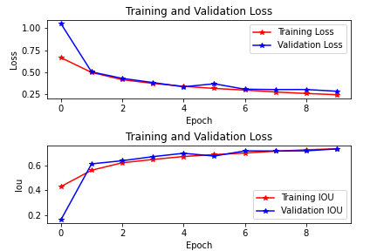
Results – mean IoU
Model 0 – DenseUNet with regular conv2dtranspose
mIoU: 0.7153
Minimum mIoU amongst all of the mentioned cases.
Model 1 – DenseUNet with PixelTCL
mIoU: 0.7186
Improved mIoU with increased overfitting.
Model 2 – DenseUNet with iPixelTCL
mIoU: 0.7336
The best mIoU, along with the maximum overfitting.
Model 3 – DenseUNet with modified iPixelTCL
mIoU: 0.7222
Minimum overfitting, mIoU only second to Model 2.

Slide 15
Challenges faced
This method proposed by Gao et al was only applicable for up-sampling by 2. This can be a problem while using a pretrained model for testing the performance which uses up-sampling by a factor which isn’t a power of 2.
The parameters present in the original implementation were not fine tuned. The accuracy achieved was less than what was mentioned. It had to be fine tuned in order to improve the accuracy.
The ground truth images from the dataset (PascalVOC2012) consisted of images with white boundaries, which had not been accounted for in the code used by Gao et al, which used the number of classes (21) that didn’t include the image borders (which would have been 22). This dataset was modified to suit the implementation, which can be accessed through this link: Kaggle dataset

Slide 16
References
Pixel Deconvolutional Networks, Gao et al.
Densely Connected Convolutional Networks, Huang et al.
The one hundred layer tiramisu: Fully convolutional DenseNets for semantic segmentation; Jegou, Vazquez, Romero, Bengio et al
Densely connected convolutional networks, Huang et al
Encoder-Decoder with atrous spatial pyramidal pooling for semantic segmentation of Images, Chen et al
U-Nets: Convolutional neural networks for Image Segmentation, Ronneberger et al
Deeplab Xception: Separable convolutions, Chollet
Convolutions: Transposed and Deconvolution | by Mars Xiang | Medium

